Slide 1

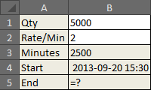
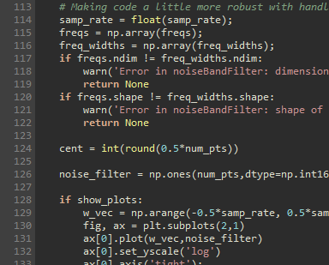
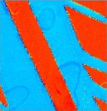
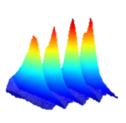

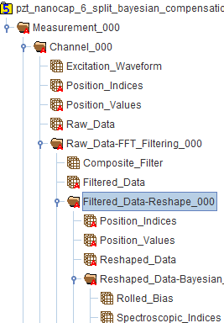
Hierarchical Data Format (HDF5)
A HDF5 file is a smart container
Capable of storing multidimensional datasets, Images, text, measurement parameters, etc.
Contents organized like traditional folders and files
Groups - Analogous to file folders
Dataset – 1 to N dimensional data
Integer, floating point, complex numbers etc
Attributes – {Key : value} pairs useful for describing data and experimental parameters, etc.
Easily accessible – C, C++, python, Java….
Tree structure + nomenclature +attributes are records of workflow applied to dataset
Parallel read / write, HPC & cloud compatible

